Slide 1
13.3 Structure of Society
Financial Statistics Project
Example slides
Dr. Huson
11.x Precalculus
Due 10PM Wednesday June 7th

Slide 2
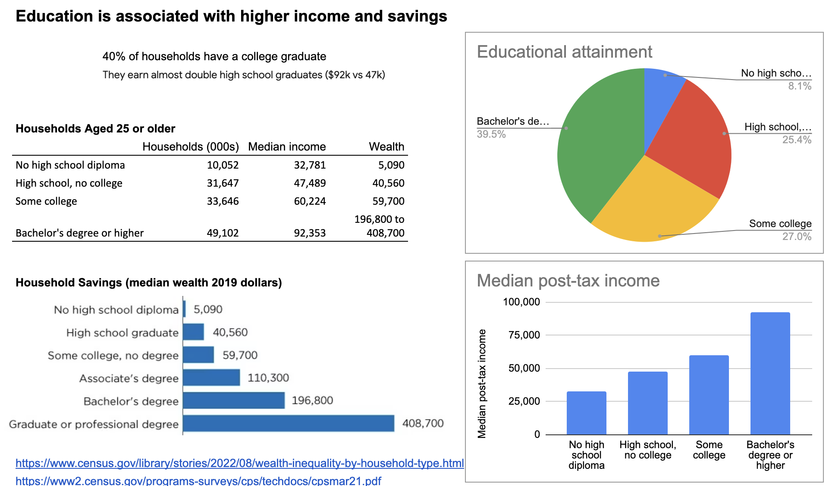

Slide 3
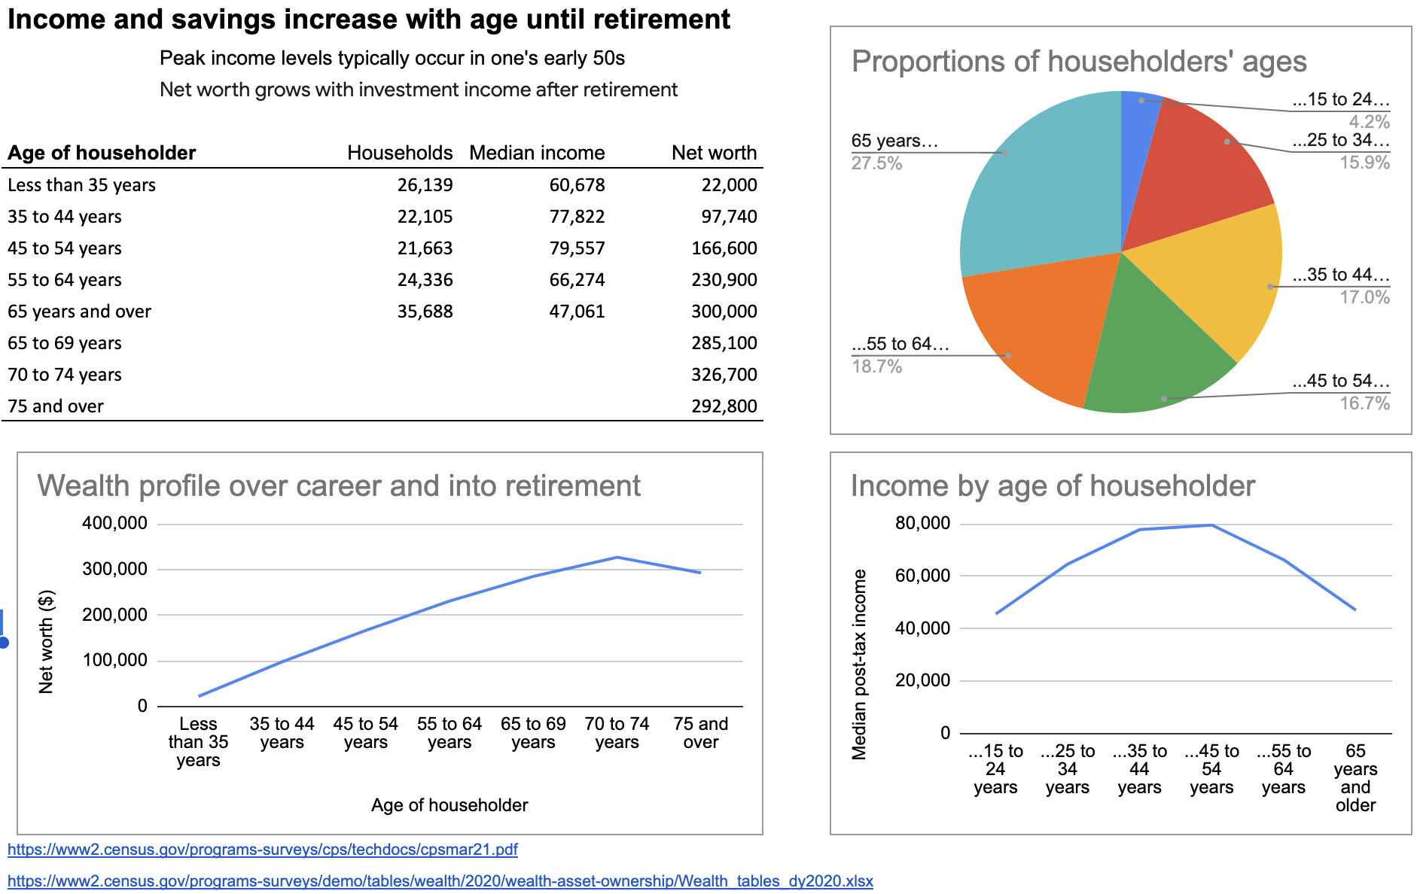

Slide 4
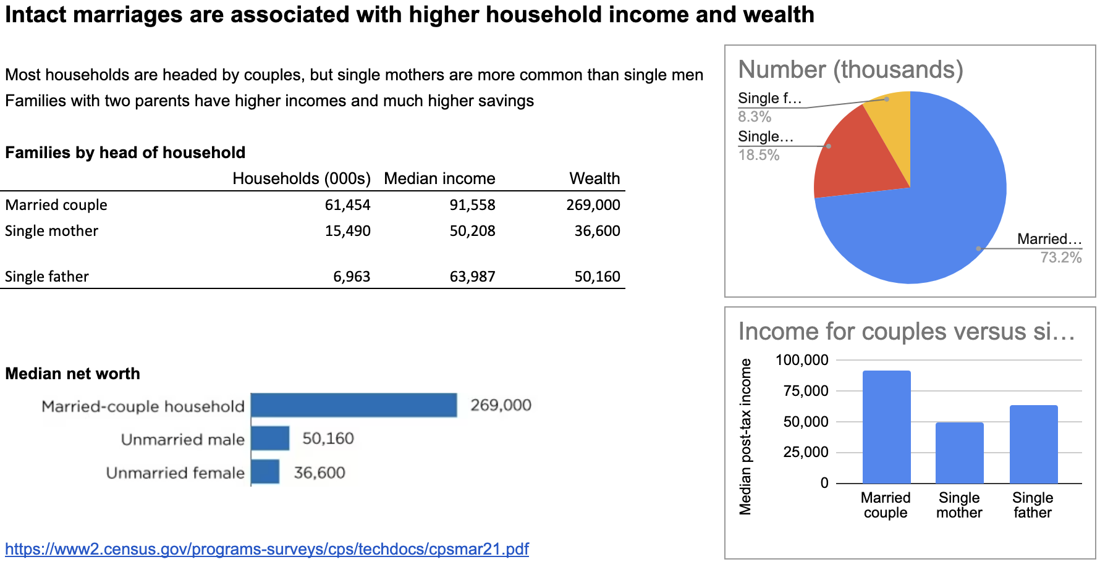

Slide 5
Component checklist
Include each student’s first and last name
Use formatted spreadsheet pages (rename logically, e.g.:
Slides are titled and include text, data, and graphics
Charts may be a combination of copied graphics
plus at least an example of your own charts
Cite all sources
Submit your spreadsheet to the Google Classroom
(each student separately)

